Slide 2
LETS SEE HOW TO IMPLEMENT THIS IN TL- VERILOG USING MAKERCHIP IDE

Slide 3
1. Go on this link and click on starting-point code https://github.com/stevehoover/VSDOpen2020_TLV_RISC-V_Tutorial
2. All the code is inbuilt and you need to fill the TBD space by your own .

Slide 4
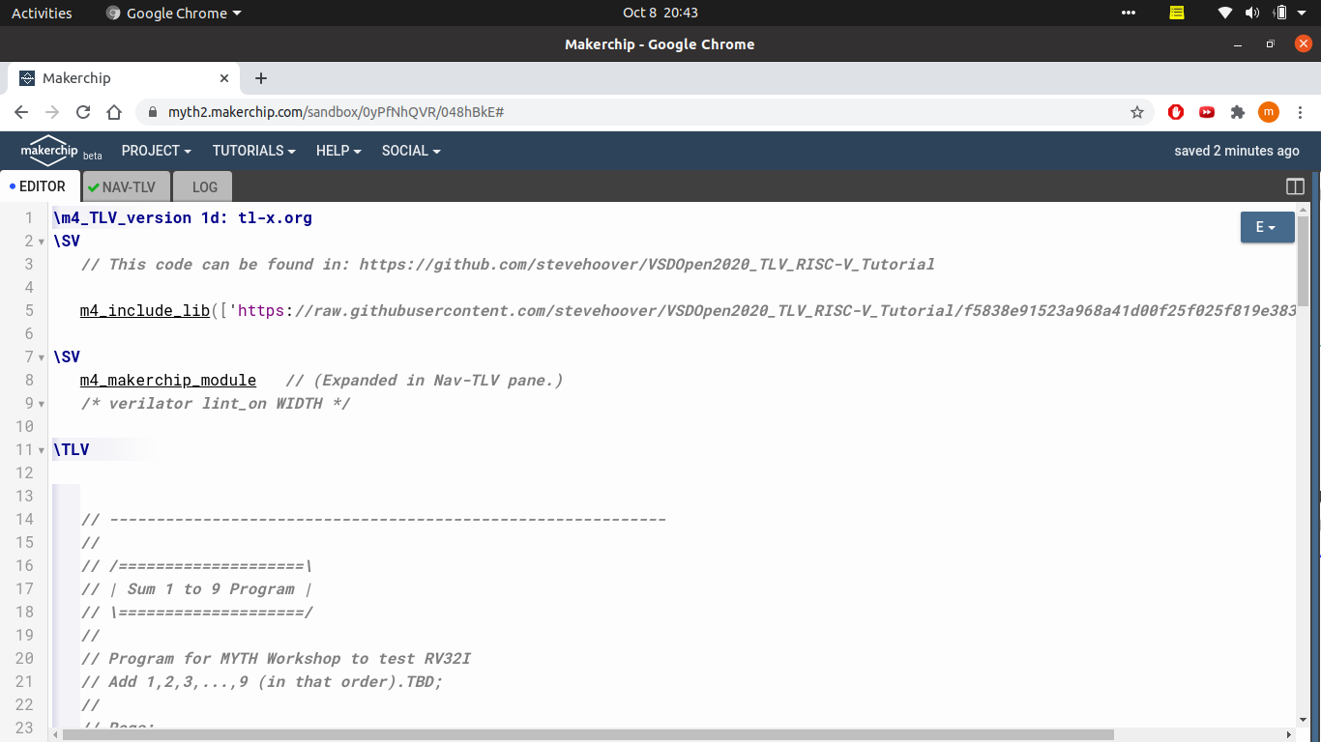
You will find a screen like this

Slide 5
You can see the top two lines in NAV-TLV block where we can see it is exactly the same thing as we instantiate a module in verilog

Slide 6
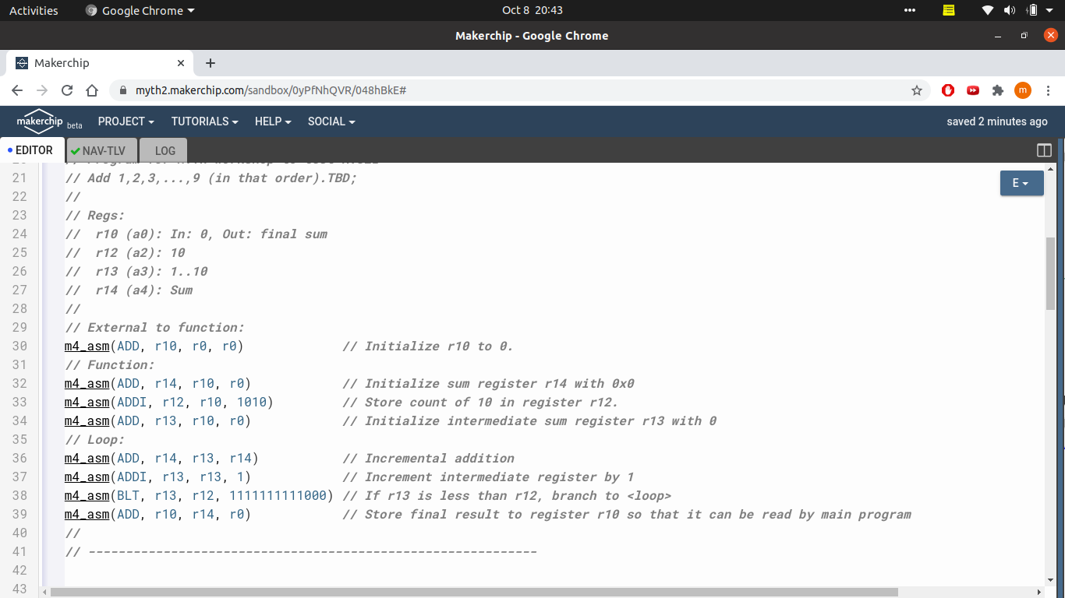
This peice of code tells the compiler that we will check compile the following asm code as we saw in the video in the first slide.

Slide 7
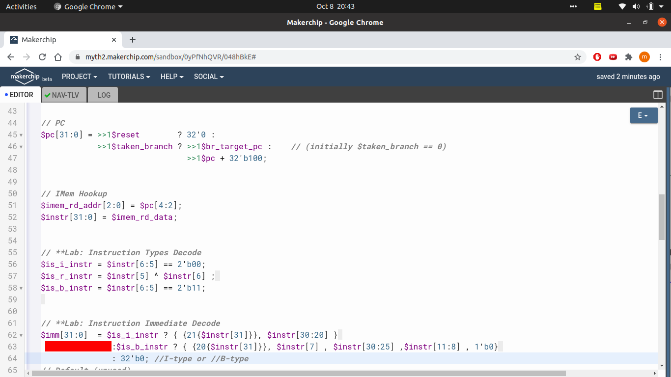
From this we started to write our code and try to explain it also
FETCH

Slide 8
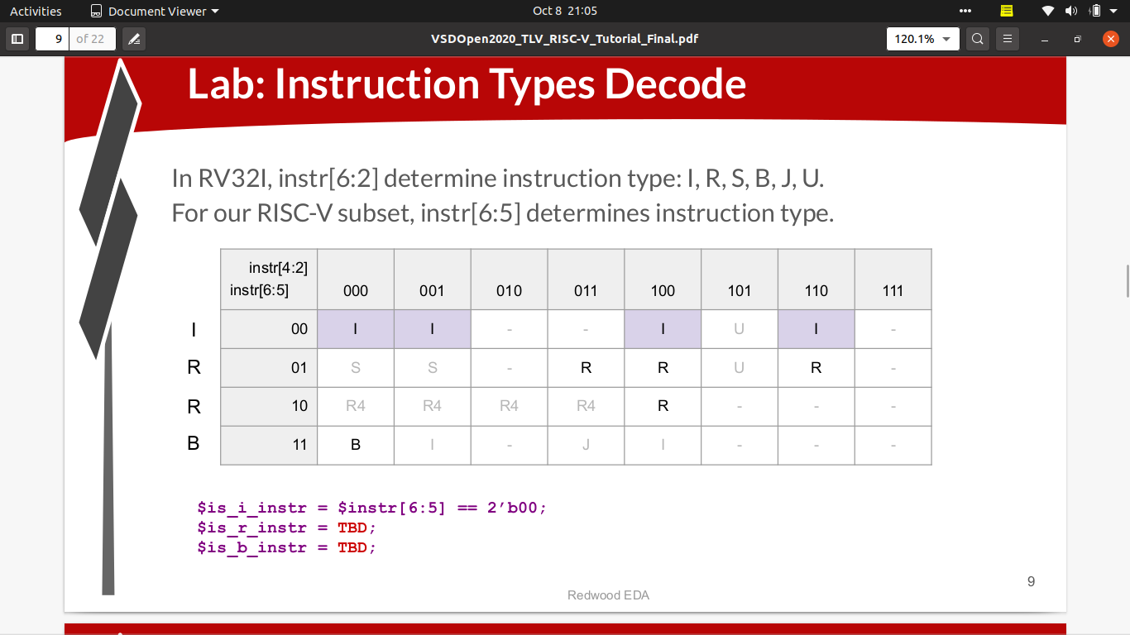
From this slide we will complete the lab instruction type decode - part

Slide 9
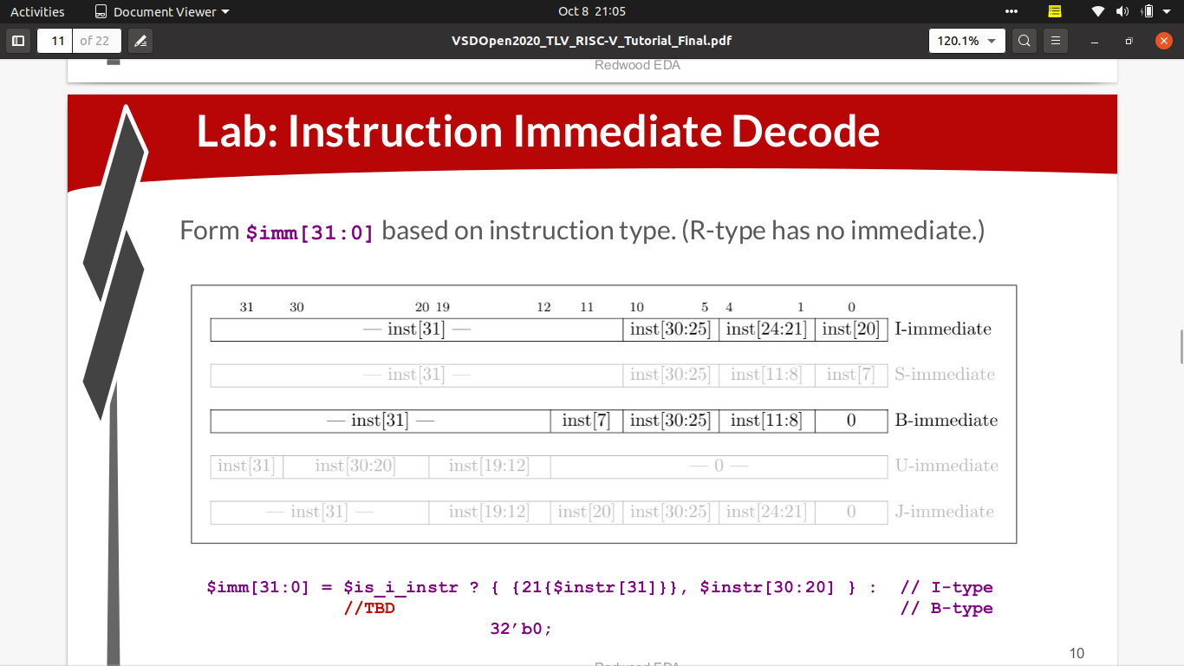
From this slide we will complete the instruction immediate decode – part

Slide 10
1. We are initiating PC to be on start of our asm code and check whether it is branced or not.
2. Then we are hooking up our memory with binary values of 32 bits .
3. Then we will initialize a 32 bit instruction-reg which will take up the first instruction .
4. From this instruction, we will now decode the instruction .
5. In this slide we are decoding whether it is i-type instruction or r-type or b-type using slide-8 .
6. Then we are finding the 16-bit immediate value using slide -9 .

Slide 11
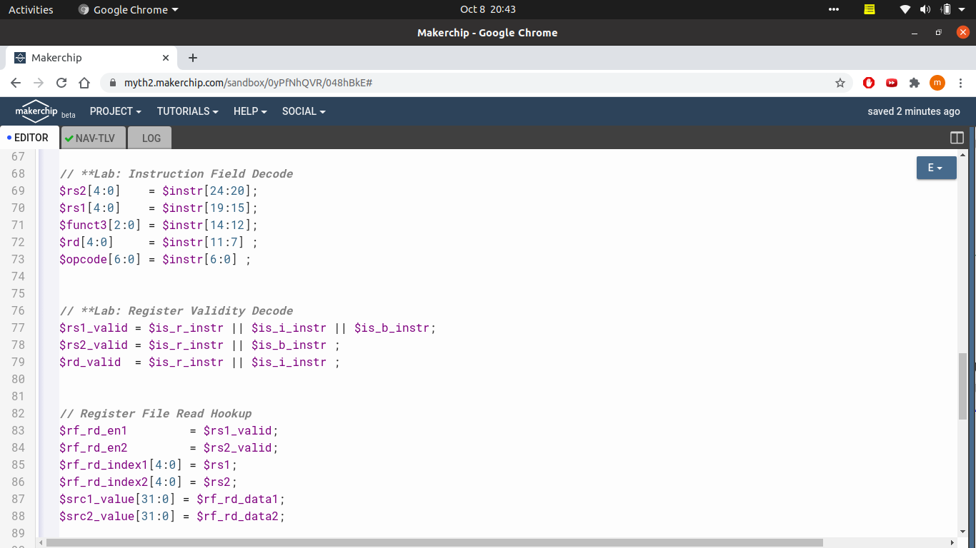
DECODE

Slide 12
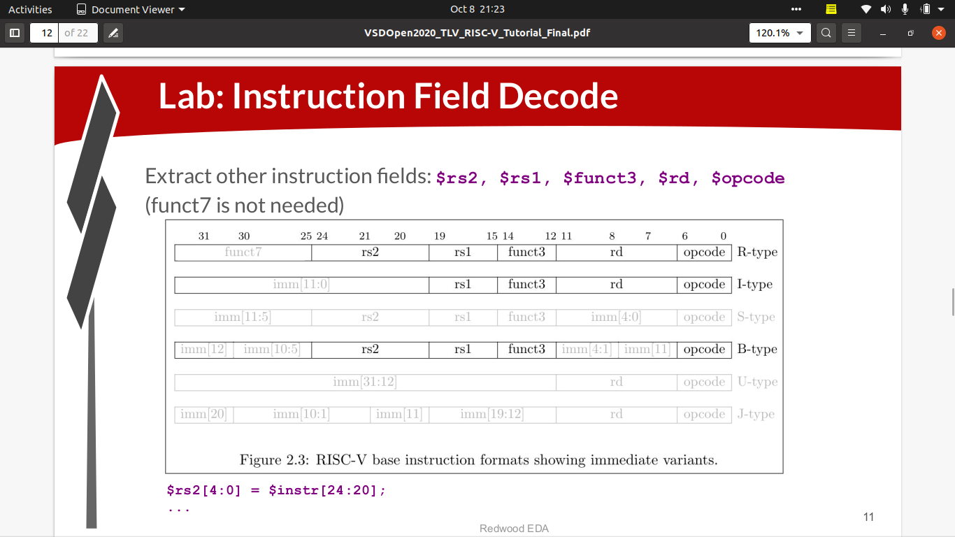

Slide 13
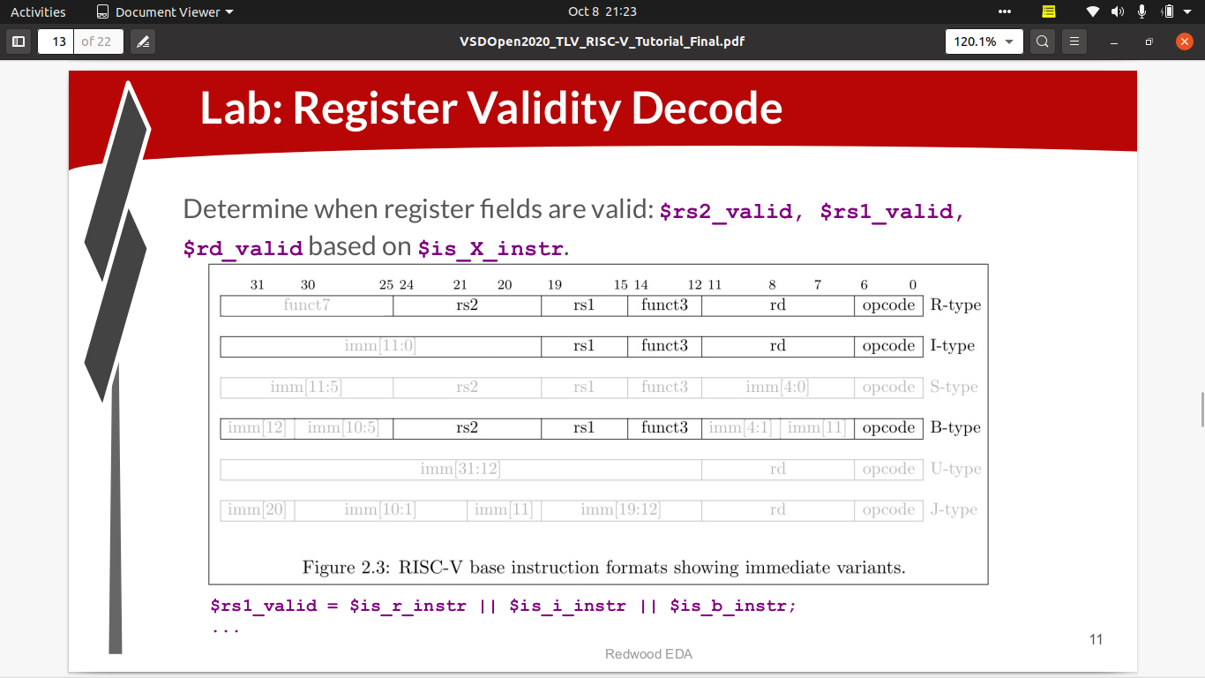

Slide 14
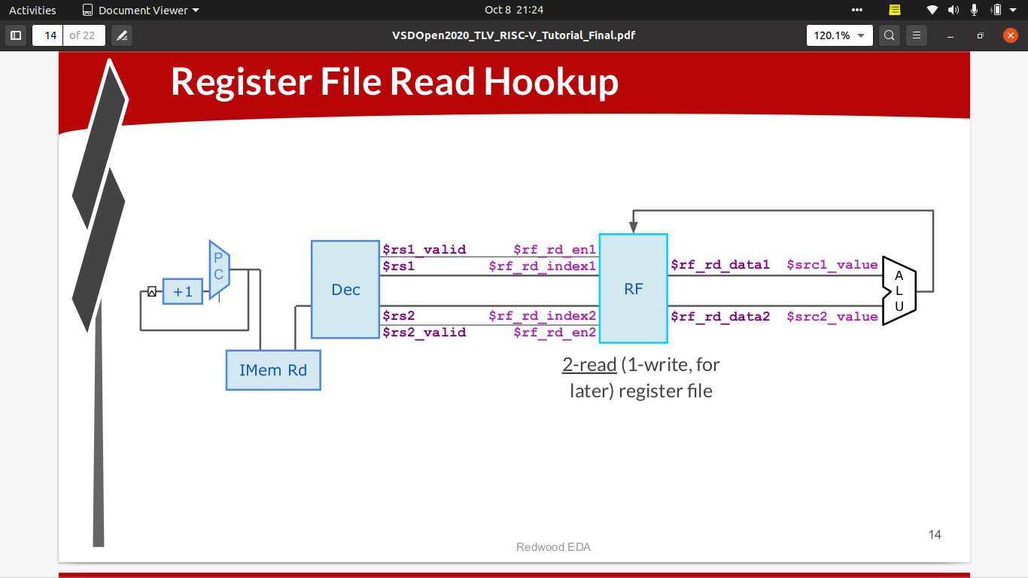

Slide 15
1. In this slide we will be decoding our instruction and putting every bits in their respective registers using slide 12
2. Now we will check whether in the following instruction if we require the register to read the data from memory . If it it require then it valid and set to 1 otherwise invalid and set to 0.
3.Now from register file read hookup we will read the values of register for further use according to the type of instruction .

Slide 16
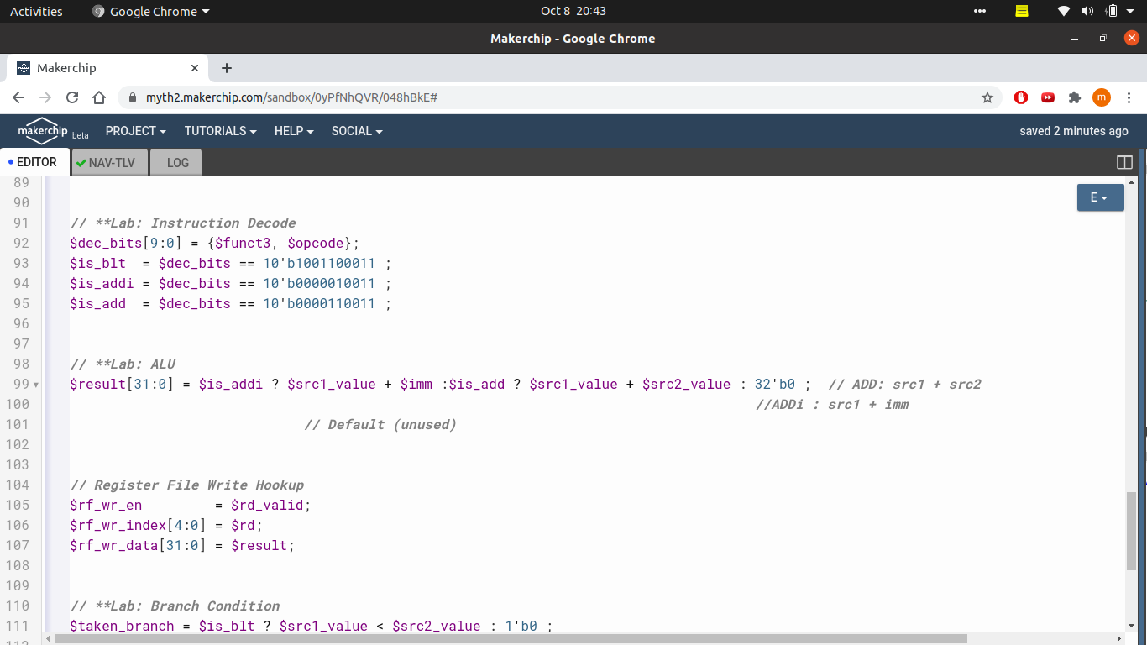
EXECUTE

Slide 17
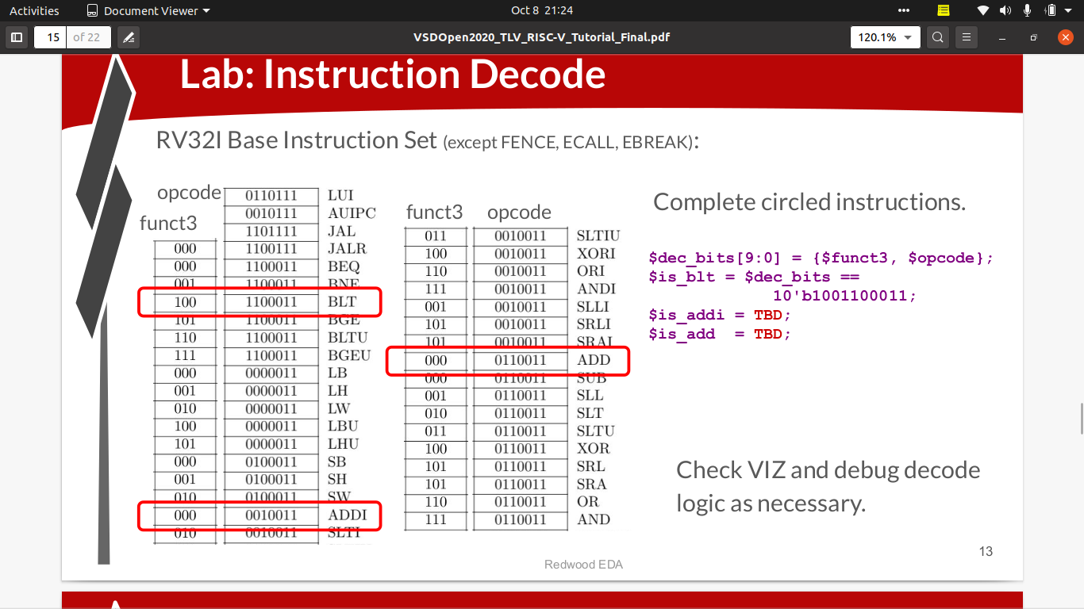

Slide 18
1. In this slide , in instruction decode , we find the opcode using slide-16.
2. NOTE – We are using only three instructions ADD , ADDI , BLT
3. Now we will execute the instruction whether it is ADD or ADDI in the ALU .
4. Then we will write the result back to register file .

Slide 19
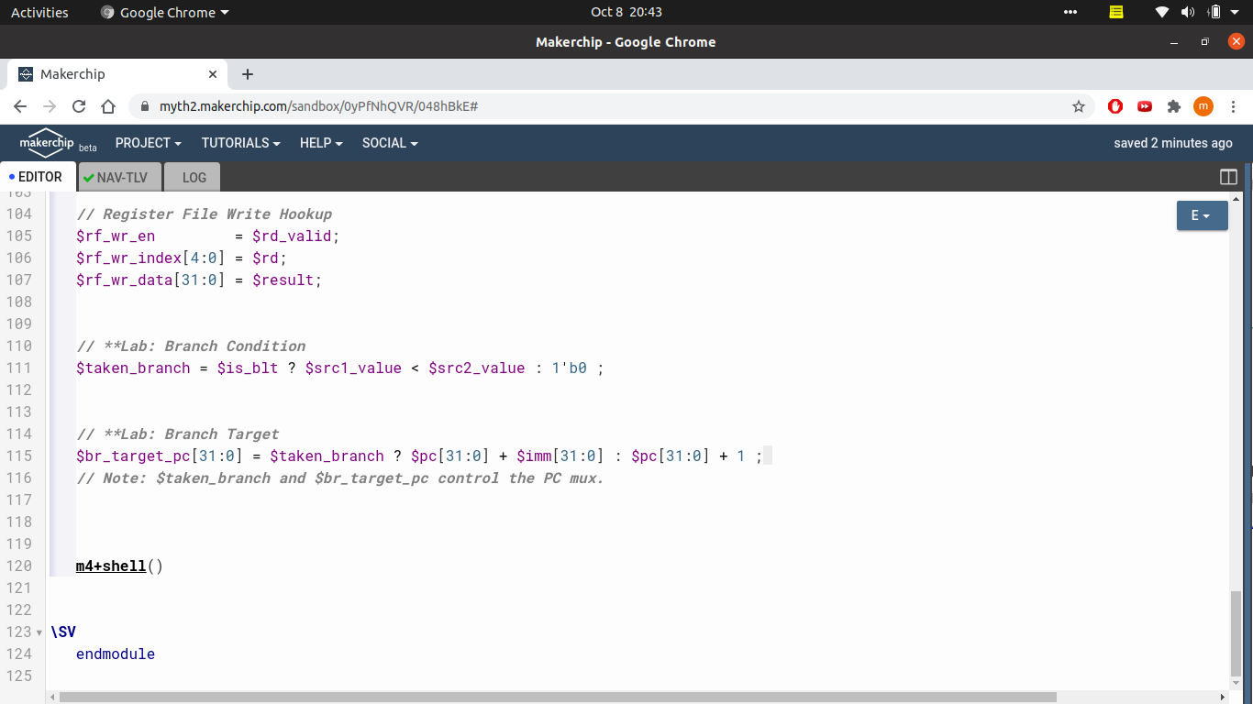
BRANCHING

Slide 20
1. In this slide we will check if a branch is there i.e if BLT instruction is used .
For this we will check both the read register such that reg1 is less than reg2 . If it is so then we will take the branch otherwise not .
2. If branch is taken then we will jump to a specific instruction which can be obtained by PC + imm_value.
Otherwise we will normally increment PC by 1 .

Slide 21
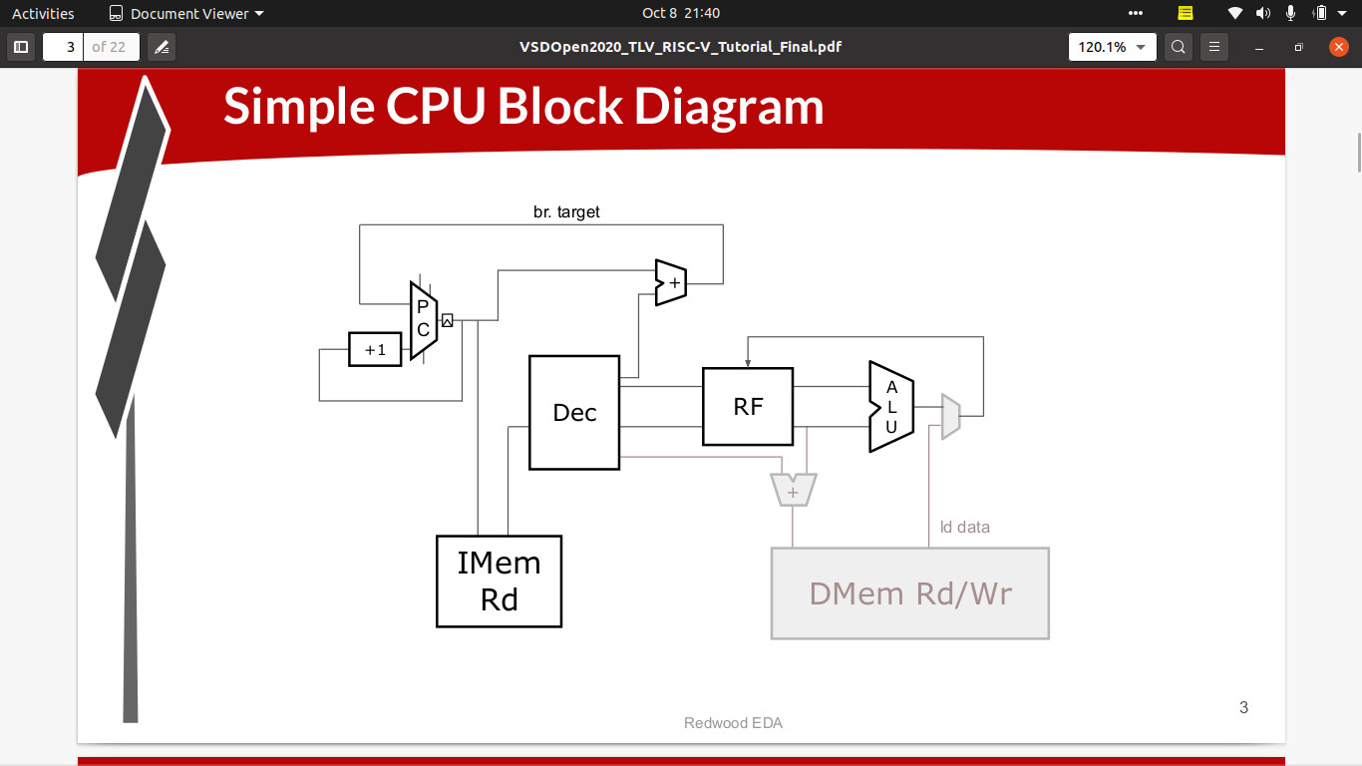
This is the simple CPU block diagram

Slide 22
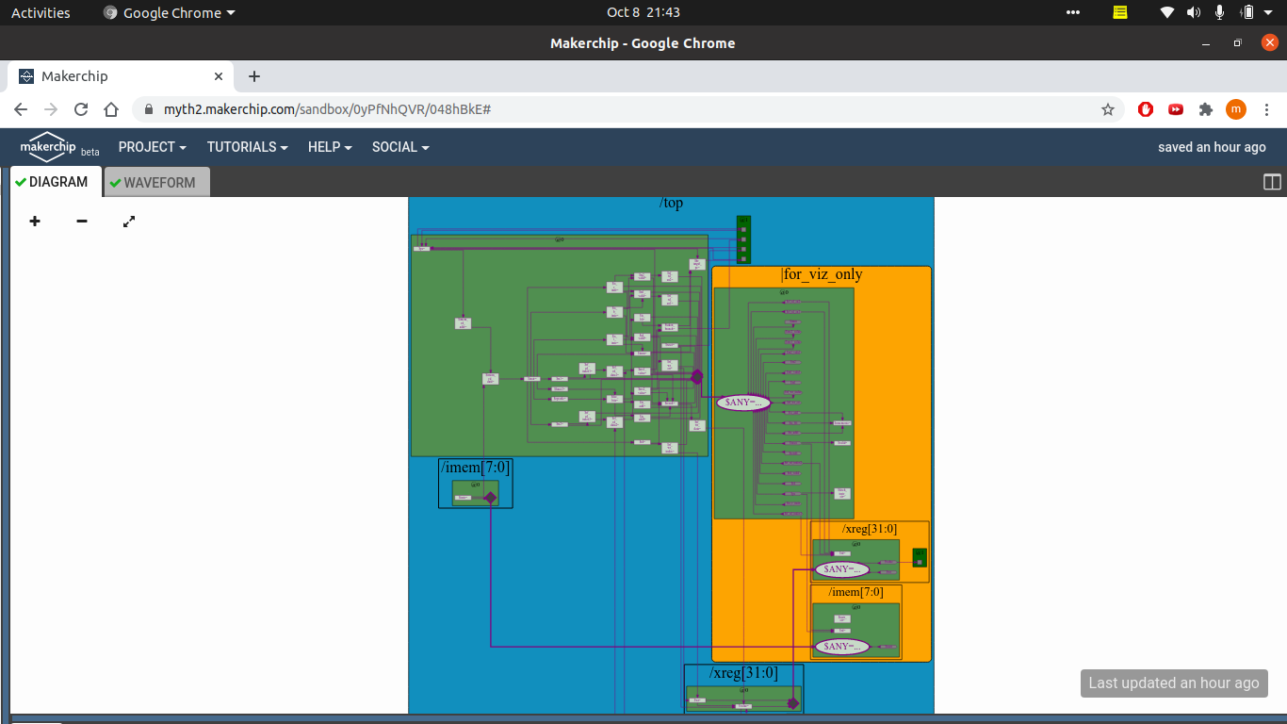
This is the Block diagram

Slide 23
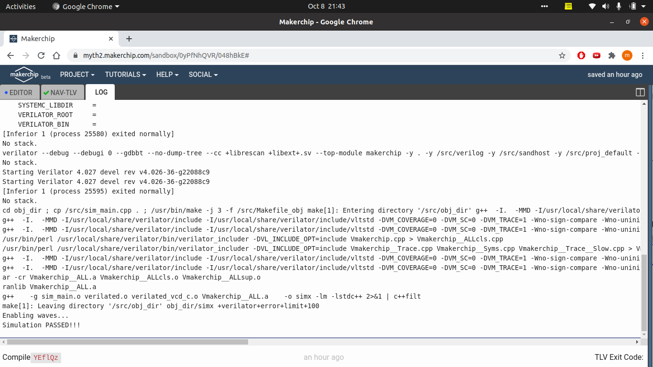
This is the log file
In the end if your code is correct you will see Simulation passed

Slide 24
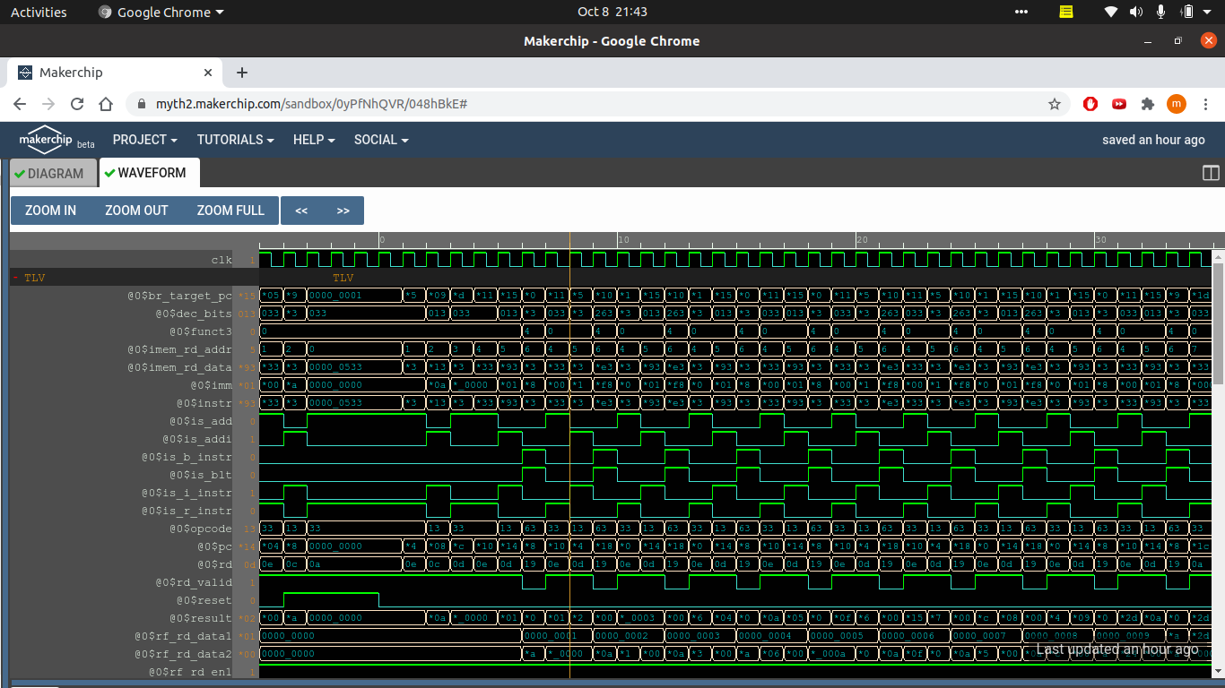
These are the waveforms from where you can debug your code .

Slide 25
Special thanks to -
Steeve hoover - https://github.com/stevehoover
Vineet jain - https://github.com/vineetjain07
Shivam Potdar-https://github.com/shivampotdar

